Slide 1
CSE 486/586 Distributed Systems Consensus
Steve Ko
Computer Sciences and Engineering
University at Buffalo

Slide 2
Recap: RPC
Client Process
Server Process
Client Function
Server Function
Client Stub
Server Stub
Marshalling/unmarshalling
Socket API
Socket API

Slide 3
Recap: RPC
RPC enables programmers to call functions in remote processes.
IDL (Interface Definition Language) allows programmers to define remote procedure calls.
Stubs are used to make it appear that the call is local.
Semantics
Cannot provide exactly once
At least once
At most once
Depends on the application requirements

Slide 4

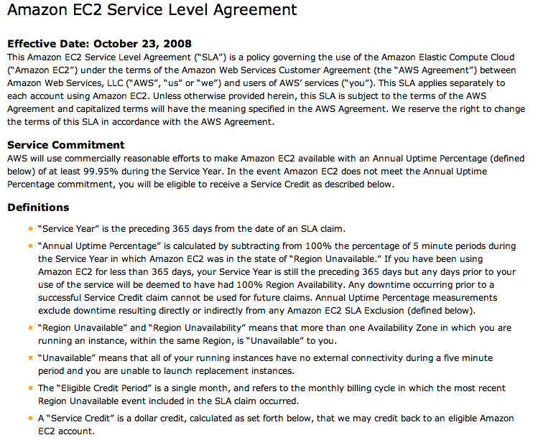
Let’s Consider This…

Slide 5
One Reason: Impossibility of Consensus
Q: Should Steve give an A to everybody taking CSE 486/586?
Input: everyone says either yes/no.
Output: an agreement of yes or no.
Bad news
Asynchronous systems cannot guarantee that they will reach consensus even with one faulty process.
Many consensus problems
Reliable, totally-ordered multicast (what we saw already)
Mutual exclusion, leader election, etc. (what we will see)
Cannot reach consensus.

Slide 6
The Consensus Problem
N processes
Each process p has
input variable x_{p} : initially either 0 or 1
output variable y_{p} : initially b (b=undecided) – can be changed only once
Consensus problem: Design a protocol so that either
all non-faulty processes set their output variables to 0
Or all non-faulty processes set their output variables to 1
There is at least one initial state that leads to each outcomes 1 and 2 above

Slide 7
Assumptions (System Model)
Processes fail only by crash-stopping
Synchronous system: bounds on
Message delays
Max time for each process step
e.g., multiprocessor (common clock across processors)
Asynchronous system: no such bounds
E.g., the Internet

Slide 8
Example: State Machine Replication
Run multiple copies of a state machine
For what?
Reliability
All copies agree on the order of execution.
Many mission-critical systems operate like this.
Air traffic control systems, Warship control systems, etc.

Slide 9
First: Synchronous Systems
Every process starts with an initial input value (0 or 1).
Every process keeps the history of values received so far.
The protocol proceeds in rounds.
At each round, everyone multicasts the history of values.
After all the rounds are done, pick the minimum.

Slide 10
First: Synchronous Systems
For a system with at most f processes crashing, the algorithm proceeds in f+1 rounds (with timeout), using basic multicast (B-multicast).
Values^{r}_{i}: the set of proposed values known to process p=P_{i} at the beginning of round r.
Initially Values⁰_{i} = {} ; Values¹_{i} = {v_{i}=x_{p}}
for round r = 1 to f+1 do
multicast (Values^{r}_{i})
Values ^{r+1}_{i} ← Values^{r}_{i}
for each V_{j} received
Values ^{r+1}_{i} = Values^{r+1}_{i} ∪ V_{j}
end
end
y_{p}=d_{i} = minimum(Values^{f+1}_{i})

Slide 11
Why Does It Work?
Assume that two non-faulty processes differ in their final set of values → proof by contradiction
Suppose p_{i} and p_{j} are these processes.
Assume that p_{i} possesses a value v that p_{j} does not possess.
Intuition: p_{j} must have consistently missed v in all rounds. Let’s backtrack this.
→ In the last round, some third process, p_{k}, sent v to p_{i}, and crashed before sending v to p_{j}.
→ Any process sending v in the penultimate round must have crashed; otherwise, both p_{k} and p_{j} should have received v.
→ Proceeding in this way, we infer at least one crash in each of the preceding rounds.
→ But we have assumed at most f crashes can occur and there are f+1 rounds ==> contradiction.

Slide 12
Second: Asynchronous Systems
Messages have arbitrary delay, processes arbitrarily slow
Impossible to achieve consensus
even a single failed is enough to avoid the system from reaching agreement!
a slow process indistinguishable from a crashed process
Impossibility applies to any protocol that claims to solve consensus
Proved in a now-famous result by Fischer, Lynch and Patterson, 1983 (FLP)
Stopped many distributed system designers dead in their tracks
A lot of claims of “reliability” vanished overnight

Slide 13
Are We Doomed?
Asynchronous systems cannot guarantee that they will reach consensus even with one faulty process.
Key word: “guarantee”
Does not mean that processes can never reach a consensus if one is faulty
Allows room for reaching agreement with some probability greater than zero
In practice many systems reach consensus.
How to get around this?
Two key things in the result: one faulty process & arbitrary delay

Slide 14
Techniques to Overcome Impossibility
Technique 1: masking faults (crash-stop)
For example, use persistent storage and keep local checkpoints
Then upon a failure, restart the process and recover from the last checkpoint.
This masks fault, but may introduce arbitrary delays.
Technique 2: using failure detectors
For example, if a process is slow, mark it as a failed process.
Then actually kill it somehow, or discard all the messages from that point on (fail-silent)
This effectively turns an asynchronous system into a synchronous system
Failure detectors might not be 100% accurate and requires a long timeout value to be reasonably accurate.

Slide 15
CSE 486/586 Administrivia
PA2 due in 1 week
Will give you an apk that tests your content provider.
More help by TAs next week
Practice problem set 1 & midterm example posted on the course website.
Will post solutions on Monday
Midterm on Wednesday (3/6) @ 3pm
Not Friday (3/8)
Come talk to me!

Slide 16
Recall
Each process p has a state
program counter, registers, stack, local variables
input register xp : initially either 0 or 1
output register yp : initially b (b=undecided)
Consensus Problem: Design a protocol so that either
all non-faulty processes set their output variables to 0
Or non-faulty all processes set their output variables to 1
(No trivial solutions allowed)

Slide 17
Proof of Impossibility: Reminder
State machine
Forget real time, everything is in steps & state transitions.
Equally applicable to a single process as well as distributed processes
A state (S1) is reachable from another state (S0) if there is a sequence of events from S0 to S1.
There an initial state with an initial set of input values.

Slide 18
p
p’
send(p’,m)
receive(p’)
may return null
Global Message Buffer
“Network”

Slide 19
Different Definition of “State”
State of a process
Configuration: = Global state. Collection of states, one per process; and state of the global buffer
Each Event consists atomically of three sub-steps:
receipt of a message by a process (say p), and
processing of message, and
sending out of all necessary messages by p (into the global message buffer)
Note: this event is different from the Lamport events
Schedule: sequence of events

Slide 20
C
Configuration C
C
Event e’=(p’,m’)
C’
Schedule s=(e’,e’’)
C’’
Event e’’=(p’’,m’’)
C’’
Equivalent

Slide 21
Lemma 1
Schedules are commutative
C
Schedule s2
Schedule s1
s1 and s2
can each be applied
to C
involve
disjoint sets of
receiving processes
C’
s2
s1
C’’

Slide 22
State Valencies
Let config. C have a set of decision values V reachable from it
If |V| = 2, config. C is bivalent
If |V| = 1, config. C is said to be 0-valent or 1-valent, as is the case
Bivalent means that the outcome is unpredictable (but still doesn’t mean that consensus is not guaranteed).

Slide 23
Guaranteeing Consensus
If we want to say that a protocol guarantees consensus (with one faulty process & arbitrary delays), we should be able to say the following:
Consider all possible input sets
For each input set (i.e., for each initial configuration), the protocol should produce either 0 or 1 even with one failure for all possible execution paths (runs).
The impossibility result: We can’t do that.

Slide 24
The Theorem
Lemma 2: There exists an initial configuration that is bivalent
Lemma 3: Starting from a bivalent config., there is always another bivalent config. that is reachable
Theorem (Impossibility of Consensus): There is always a run of events in an asynchronous distributed system (given any algorithm) such that the group of processes never reaches consensus (i.e., always stays bivalent)

Slide 25
Summary
Consensus: reaching an agreement
Possible in synchronous systems
Asynchronous systems cannot guarantee.
Asynchronous systems cannot guarantee that they will reach consensus even with one faulty process.

Slide 26
Acknowledgements
These slides contain material developed and copyrighted by Indranil Gupta (UIUC).

